Slide 1
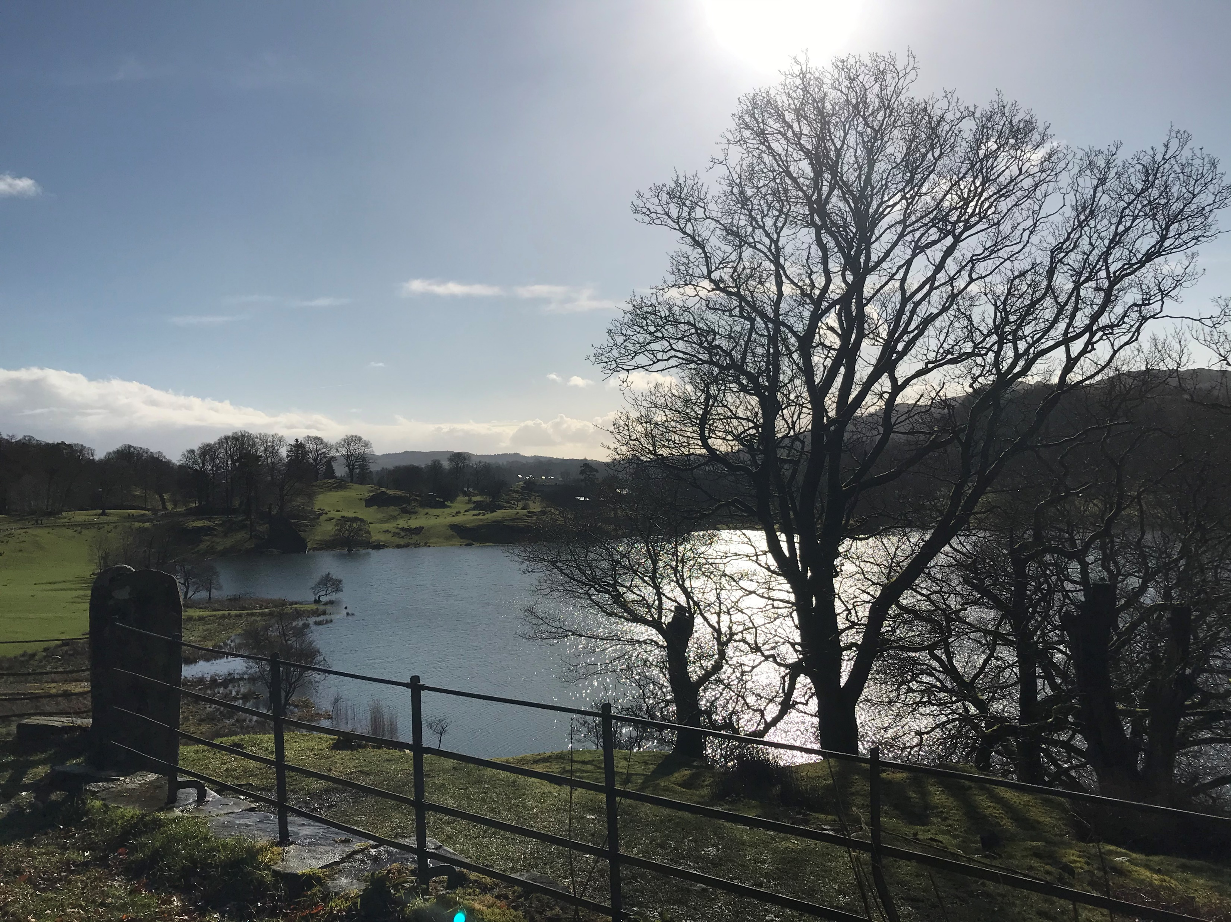

Slide 2
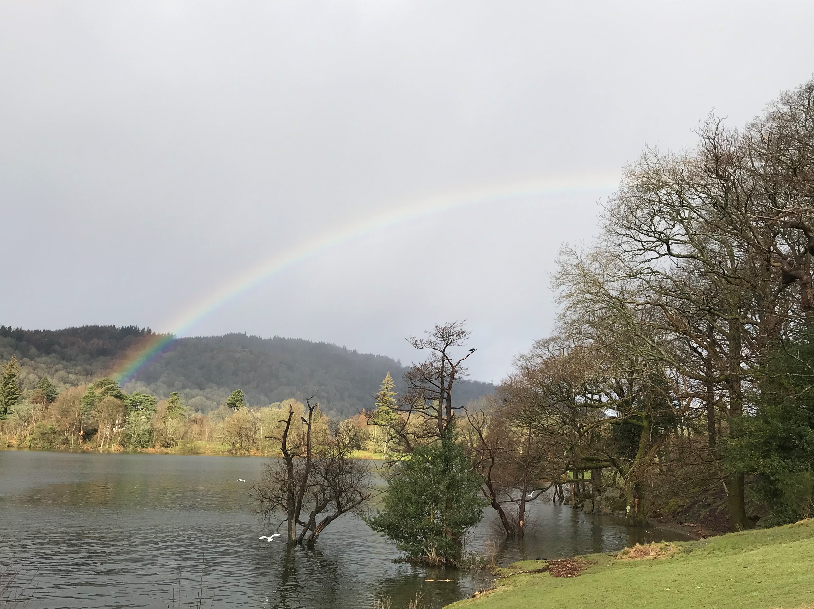

Slide 3
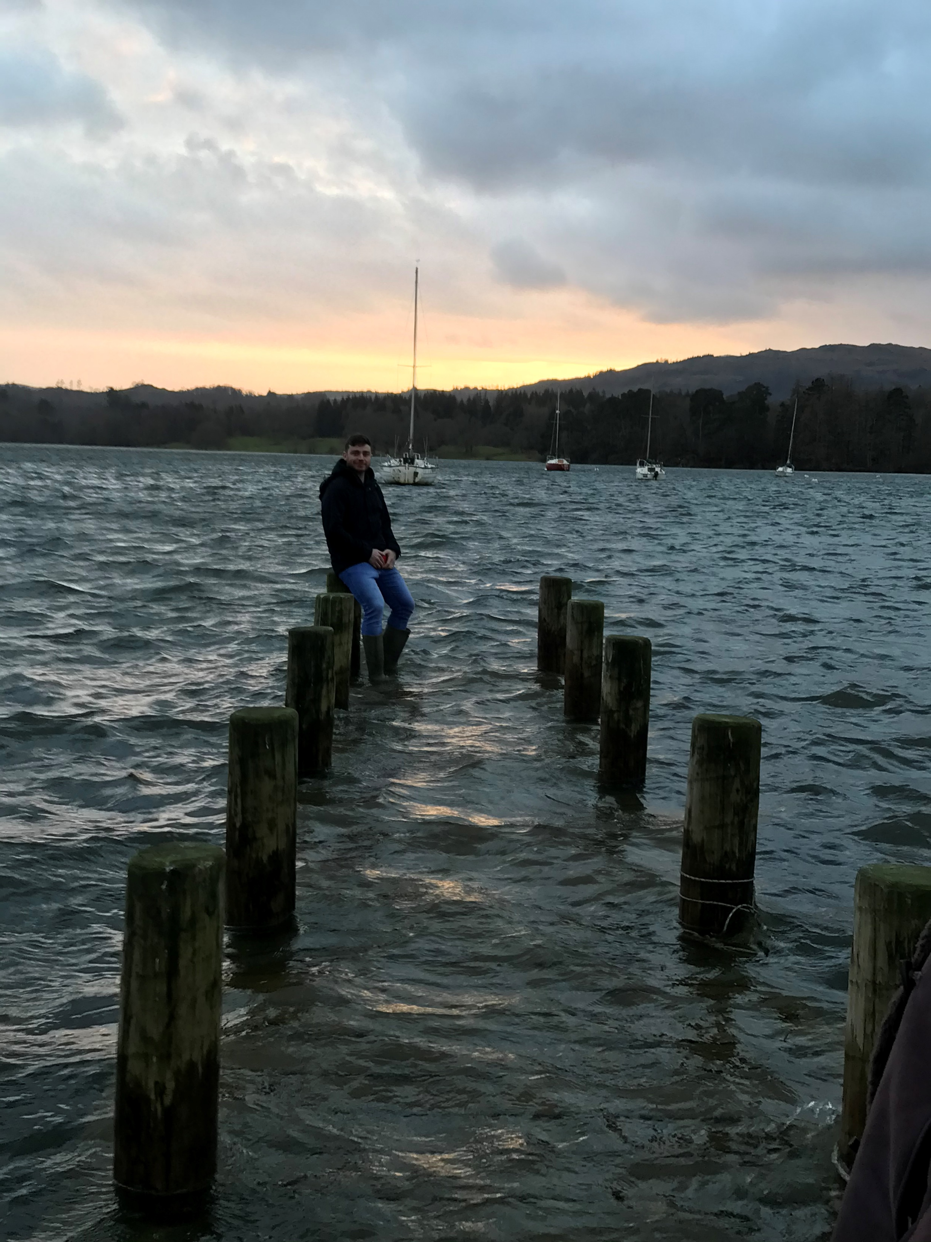

Slide 4
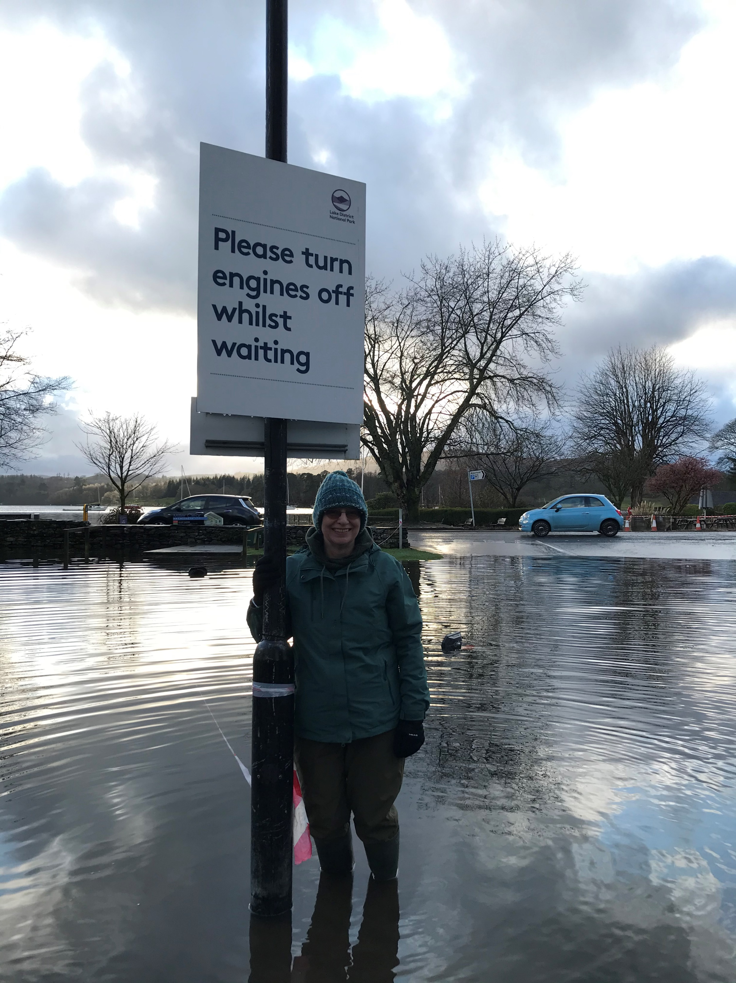

Slide 5
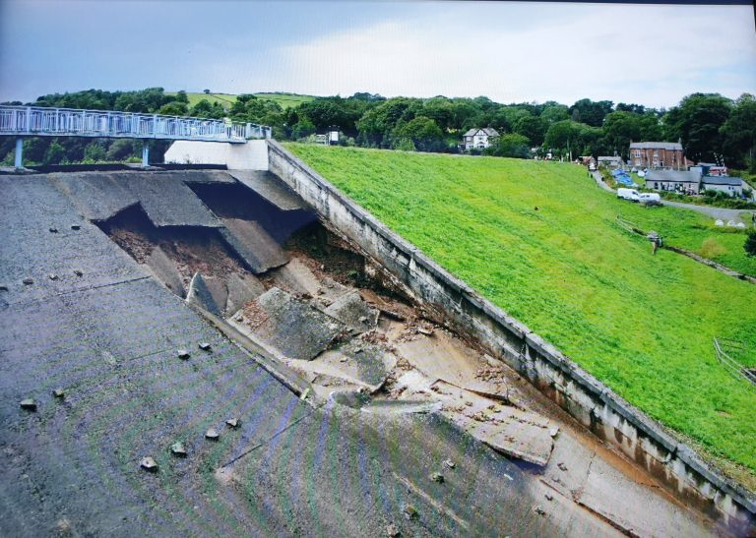

Slide 6
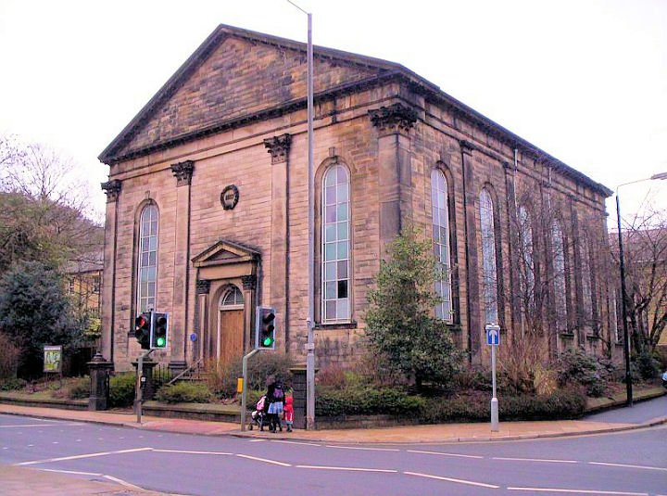

Slide 7
Water flows through the Gospel of John…
John baptises with water; will be followed by one who baptises with the Spirit (1)
Wedding at Cana: 6 stone jars of water used for purification become wine (2)
Nicodemus comes to Jesus by night: need to be born of ‘water and the Spirit’ (3)
Jacob’s Well at Sychar, Jesus asks a Samaritan woman for a drink of water and offers her ‘living water’ (4)

Slide 8
Water flows through the Gospel of John…
A man unable to walk for 38 years is healed by the pool of Bethesda (5)
Jesus walks on water (6)
Jesus at the Feast of Tabernacles (water ritual using water from Siloam) (7)
Blind man sent to Siloam to wash and be healed (9)
Washes disciples feet (13)
Water and blood flow from Jesus dead body (19)

Slide 9
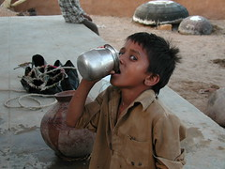

Slide 10
